Slide 1
Senior VR game presentation: Architecture Simulator
Created by: Carson McMahan

Slide 2
What my game is about!
My VR game is centered around Architecture.
Technology exists already which allows people who are looking at houses to walk through them in VR.
I wanted to build upon this concept and allow the user to interact with different models and build a house the way they see fit.
This would then be used as a template for architects to draw out plans to actually build it.

Slide 3
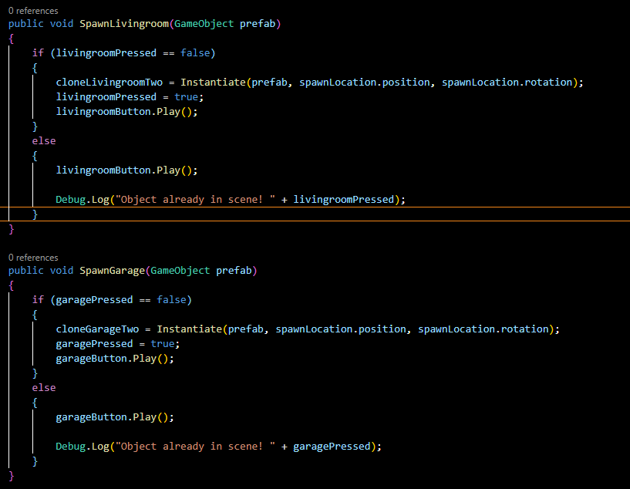
Code Snippets!
Code to the right shows two different methods
Theses methods do the same thing:
Pass a Prefab as a parameter.
Spawn the Prefab it the Boolean is false. It will then instantiate that object.
Then it will play an audio sound when the button is pressed.
If the Boolean is true nothing will happen as the object is already in the scene.

Slide 4
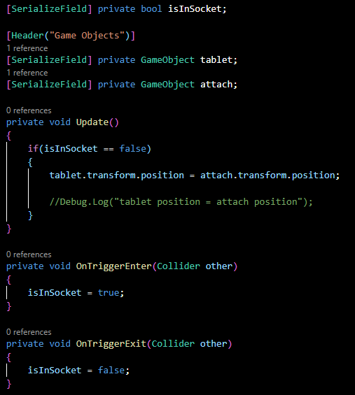
Code Snippets!
Code to the right is used to keep the teleport tablet in a specific location.
This is need so the player does not lose the ability to travel between the main room and the build site.
All this script does is check to see if the Boolean isInSocket is false.
If the Boolean is false the tablet will teleport back to the socket it is attached to.

Slide 5
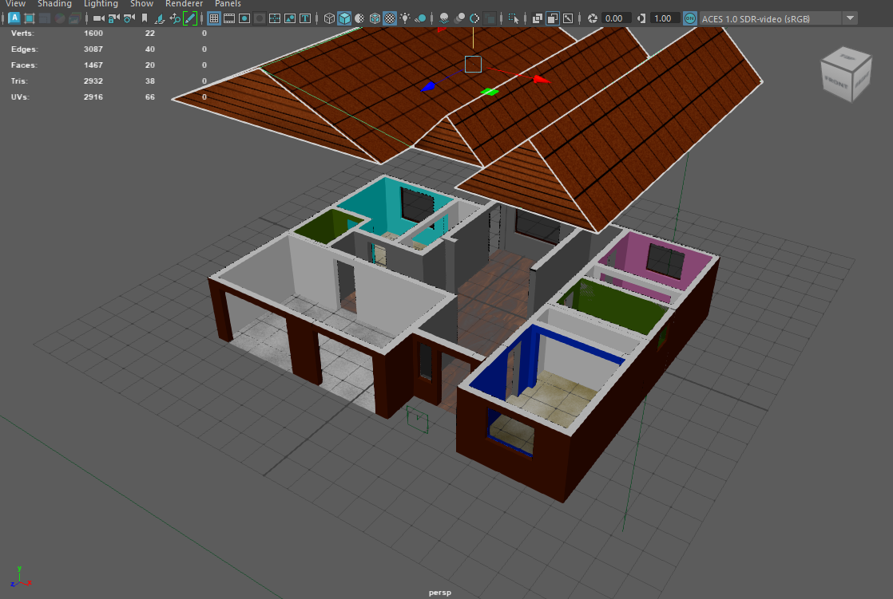
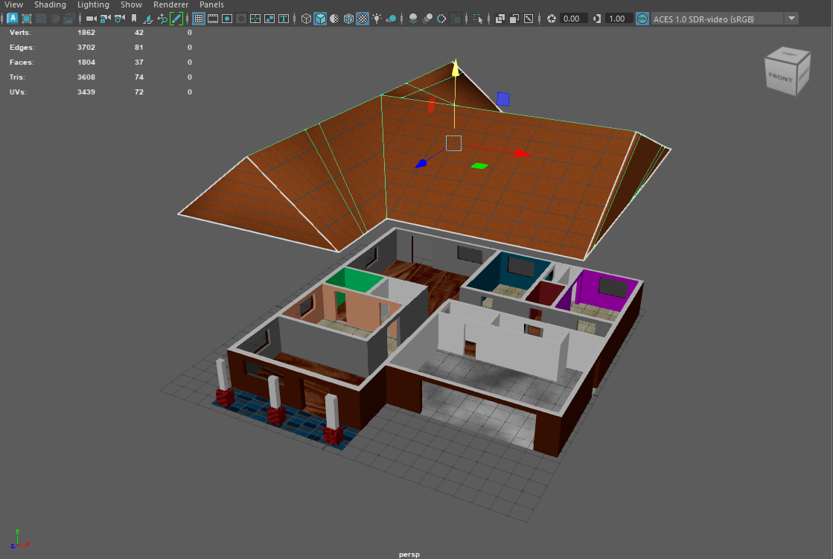
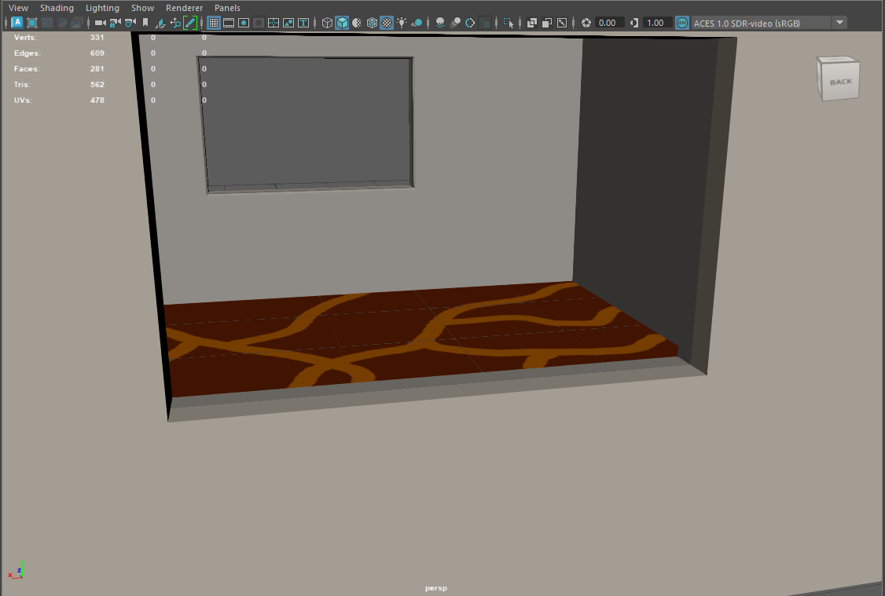
Asset Creation!
I created a total of three assets total this semester. These include:
The main hub where players will be interacting with models.
Two different single story house which will be used to place and walk through.
Each of the single story houses have rooms that were modeled individually then combined into one Maya file to be textured.

Slide 6
UX Testing Results!
How well did users interact with the environment?
Interacted with UI
Picked up an Object
Placed the Object
Used the Teleporter

Slide 7
UX Testing Results! I also asked users a series of questions after they played the game: here are some of those results:
Was there anything that was unclear? (Objective, UI, etc.)
Anything you want to see removed or added?
No, I thought the directions that were written in game were clear. I did see Carson play the game beforehand though.
No but I probably have a better understanding of technology than the people that would find this useful
No
No
No, the directions where clear
I would not allow people to put pieces of the house into the floor. Allow people to change the color of the pieces
A way to throw away pieces
Furniture
Furniture
Add nature elements.

Slide 8
Game Demo!
https://youtu.be/_btNojbWGEk

Slide 9
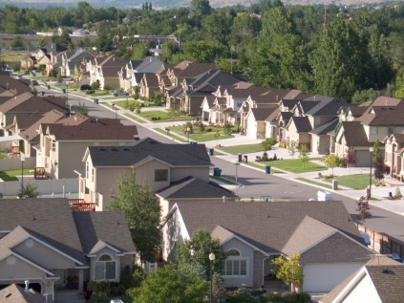
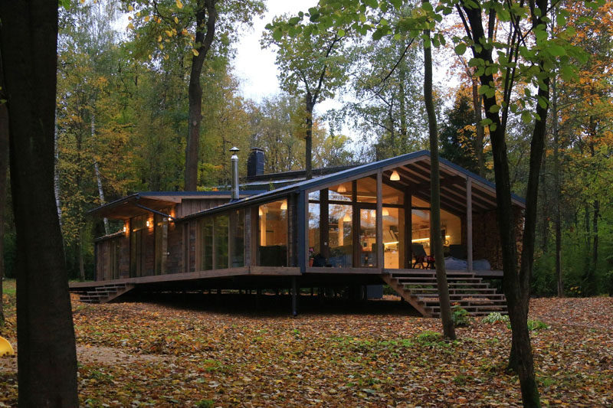
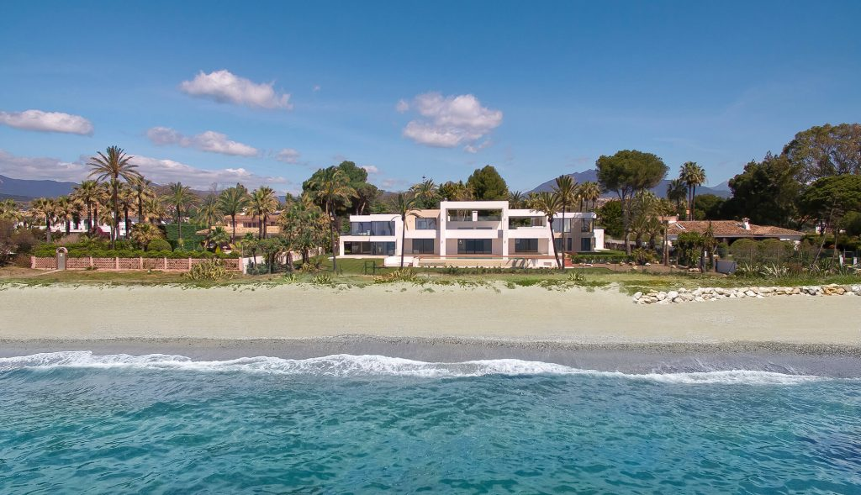
Future Plans!
Biggest thing I want to add is three environments the player can choose from.
These environments will be used to put the house on display
Suburban , forest, and beach.
Also want to add furniture to the models
Do not know to give the player the option to place them or just have them in the prefab.

Slide 10
Thank you!

